Slide 1
Supervised Machine Learning
Solving Non-Linear Equation Based Models
Ashwini Jha, Data Science Manager

Slide 2
Types of Machine Learning
Types of ML Processes
Unsupervised ML
Supervised ML
Based on Target Variable
Based on Modelling Algorithm
Regression
Classification
Rules Based (eg. Tree based algos)
Equation Based (linear regression, logistic regression, etc.)
This is our focus area today – equation based models
Linear regression or logistic regression assumes a certain fixed relationship between target variable and explanatory variables
What happens when our hypothesis frames the relationship as a non-linear equation

Slide 3

Industrial Application – purpose of learning this
Empirical Function to determine the maximum depth of corrosion in a steel tower
Imagine you are a power distribution company with many steel towers in your network
Steel towers undergo corrosion and need maintenance and repairs, mandated by safety regulations
How will you monitor the network of thousands of towers effectively?
Imagine a formula to tell you the maximum corrosion depth given the geographical characteristics:
  Depth of corrosion = f(age of tower, temperature, soil pH, voltage/potential difference between soil and tower
Such an equation can help you predict which steel towers are more severely affected and need attention in priority
You will need to solve for k₁, k₂, k₃, k₄ and k₅
Equation cannot be solved using linear regression or any standard linear model algorithms
Solving for the coefficients require a different process – metaheuristic algorithms like genetic algorithm, simulated annealing, ant-colony optimization, etc.

Slide 4
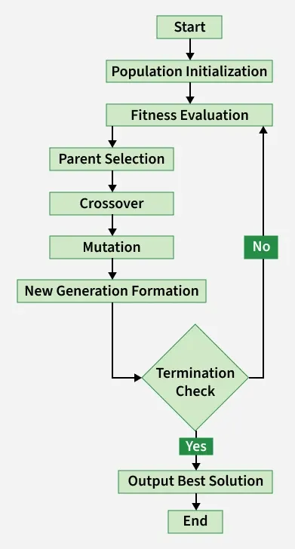
Genetic Algorithm – in focus today
Initialization: Start with random candidate solutions (chromosomes).
Selection: Pick the fittest solutions based on how well they approximate the non-linear equation.
Crossover: Combine parts of two solutions to create new ones.
Mutation: Introduce small random changes to maintain diversity.
Iteration: Repeat the cycle until the best solution converges near the true root/optimal value of the equation.

Slide 5
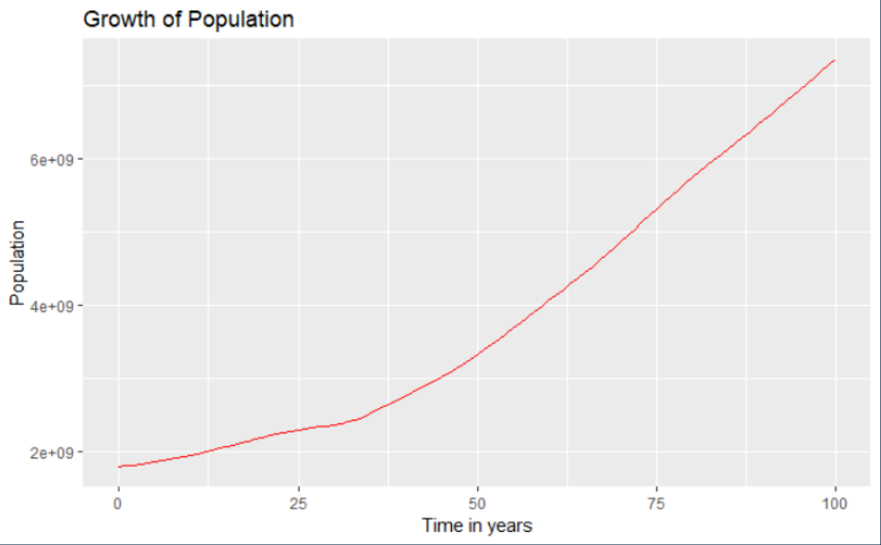

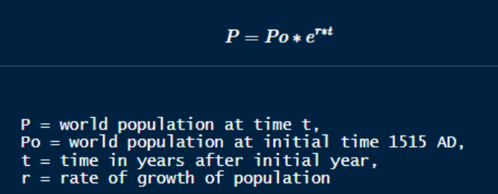
Time for some hands-on
Population growth is theorised to be an exponential process
In today’s hands-on programming, we will be solving to find out the “rate of growth” of population assuming it’s an exponential process
Solve for “r” in this equation
Notebook and slides in GitHub

